Slide 1




APPLIED PHYSICS 186 – ACTIVITY 11
--- BASIC ---
VIDEO
PROCESSING
Professor: Dr. Maricor Soriano
Instructor: Jayson Cubero
Rene L. Principe Jr.
2015-04622

Slide 2
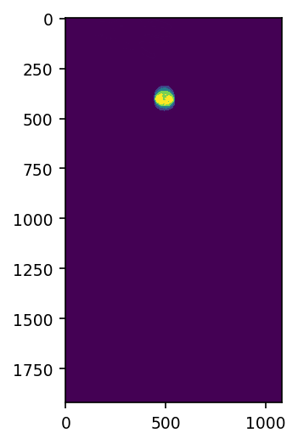
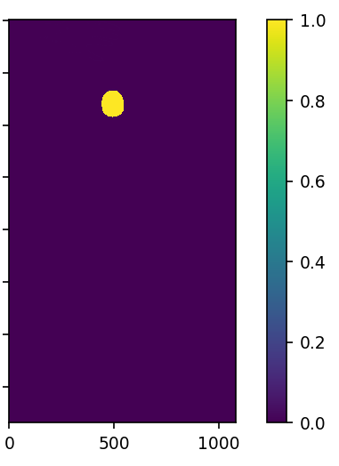
SEGMENTATION
In this activity, a classical mechanics problem was solved using a video processing approach. A video capturing a free fall motion and bouncing of a rubber ball was first converted to image frames. On each frame, non-parametric segmentation with 25 histogram bins using the pink ball as the region of interest was carried out. After thresholding the resulting segmented, the image is now sufficiently “cleaned” as shown in Figure 1. From the blob analysis technique, I was able to extract the centroid coordinates and bound the object with an ellipse. Storing theses coordinates is all that we need for classical analysis. The process is visualized further in Figs. 2 & 3.
Figure 1. A sample step consisting of non-parametric segmentation (left) and thresholding (right) implemented on a single video frame. The resulting binarized image shall be used for centroid detection.

Slide 3
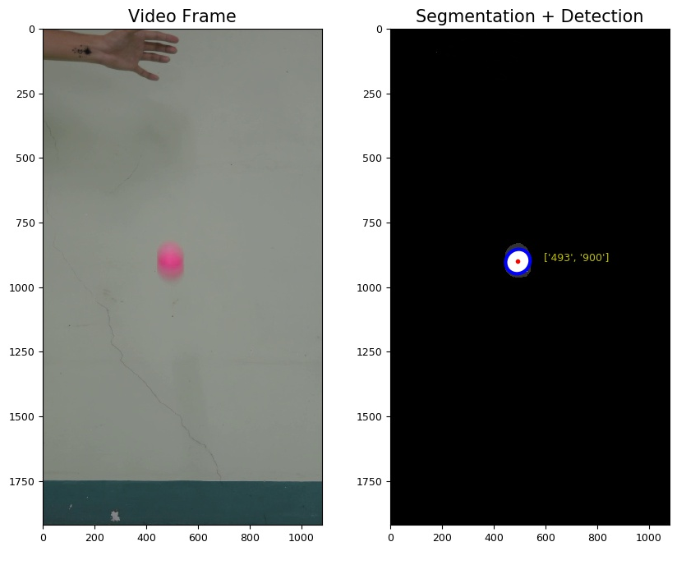
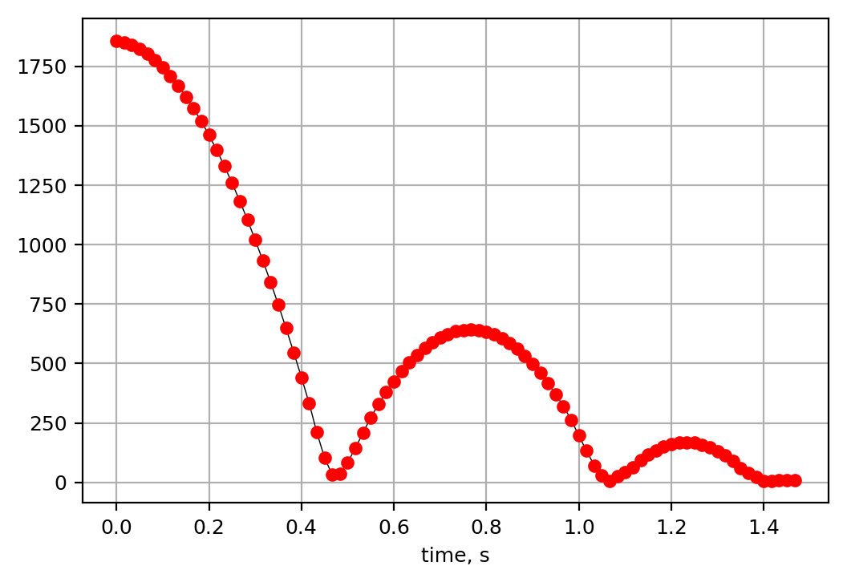
CENTROID DETECTION
Figure 2. Video Frame 18 (left) and blob detection on the segmented image of the ball (right). Coordinates of the centroid for each image frame wass stored.
Figure 3. The plot of Y-pixel values of the centroid vs time shows the free fall motion of the ball, as well as the bouncing after it hits the bottom of the frame (floor).

Slide 4
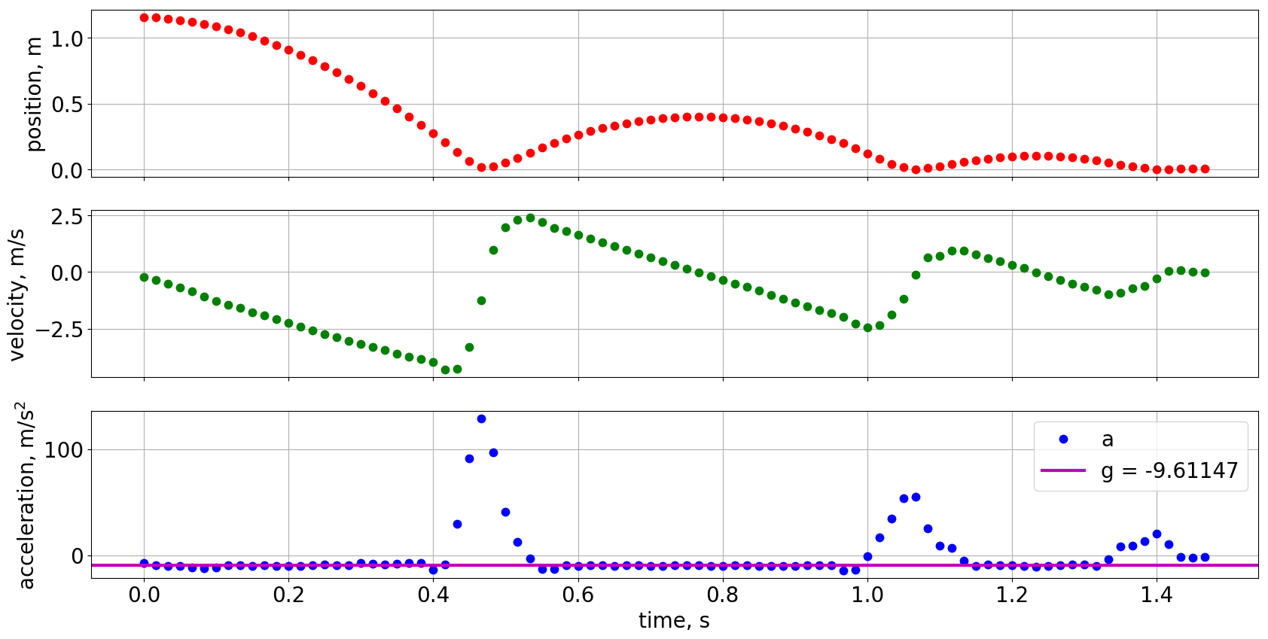
COMPUTATION
Figure 4. Y-Pixel values were converted to distance values in meters using the pixel-to-meter relation derived from the ball’s diameter in pixels. The velocity and acceleration plots were computed by taking the derivative. Experimental acceleration due to gravity turns out to be -9.61 m/s2

Slide 5
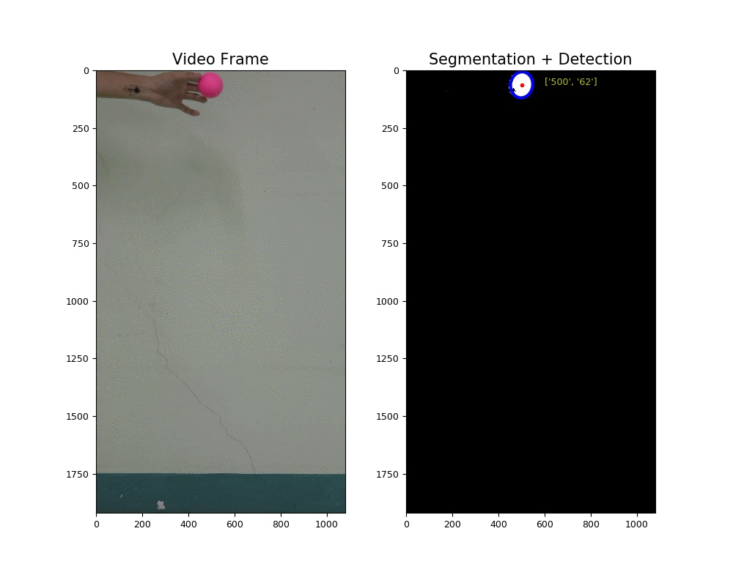
To convert pixel values to position, the pixel-to-meter relation was obtained by relating the balls diameter in meters and in pixels. It was found that 6.5 cm correspond to 104.65 pixels. Hence, the position plot was converted to meters. In Fig. 4, velocity was calculated by differentiating the time-varying position and the acceleration was taken to be the derivative of the velocity. I employed numpy.gradient for the differentiation operation. The mean acceleration for the segments when the ball was in motion is calculated to be -9.61147 m/s², around 2% error from the theoretical acceleration due to gravity. Using basic video processing, I was able to extract information necessary to solve a classical mechanics problem with high accuracy.
I want to thank Kenneth Domingo for gathering the data (video) with me and helping me with some technicalities in my coding. Here’s a GIF of my results!
In this activity, I’d give myself a 10.
References:
[1] M. Soriano, “Basic Video Processing”, 2019.

